Slide 1
Text Analytics using vectors
Azure Machine Learning Meetup
June 21, 2018

Slide 2
Recap of prior sessions and this session
1- basics of sentence structure, word standardization, cleansing etc
2 – basic statistics around words – features, bag of words, TFIDF
3 – basics of topics (LDA,LSA) – move from pure stats to some content
Tonight:
Words in context
Creating vectors to map words and their ‘neighbors’ to provide context and occurrence patterns
Word2vec, genism – sample code

Slide 3
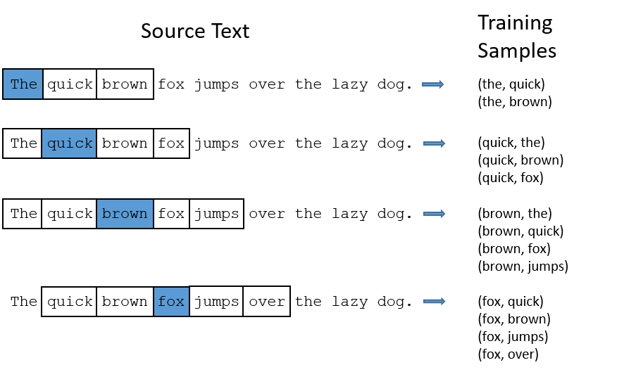
Representing “near” and “neighbor” words
http://mccormickml.com/2016/04/19/word2vec-tutorial-the-skip-gram-model/

Slide 4
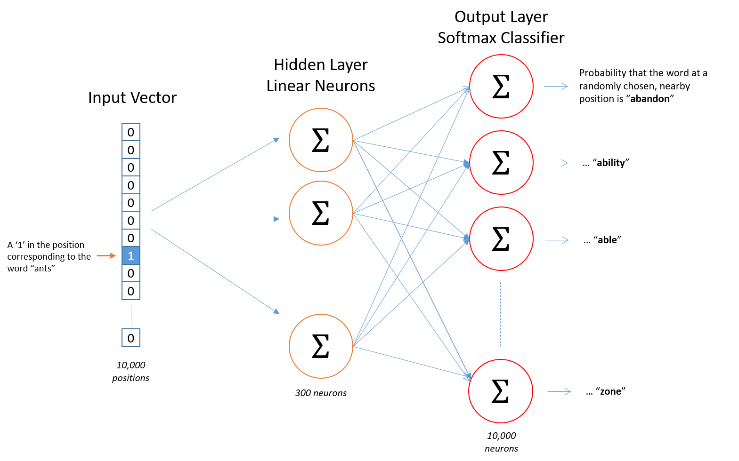
Vector mapping concepts
Input is one hot encodings of our tokens (words in a corpus)
Hidden Layer applies weights based on learning the distribution of the one hot encodings (i.e. the distribution and co-occurrence of words)
Learns via standard NN back propagation
At the end – the hidden layer acts like a lookup function for an input

Slide 5
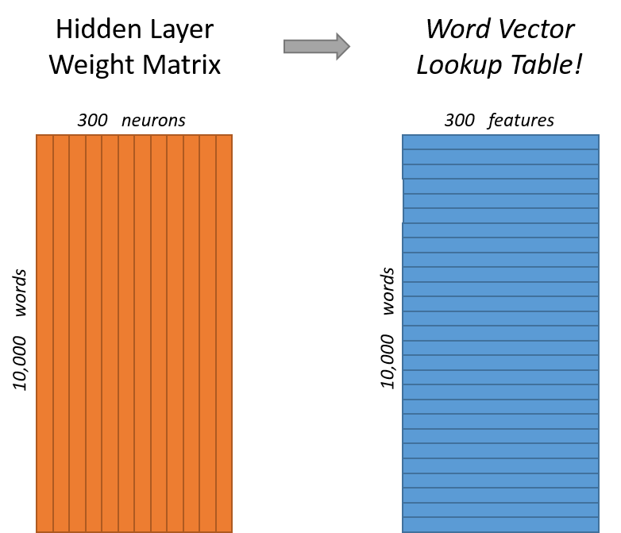

Slide 6
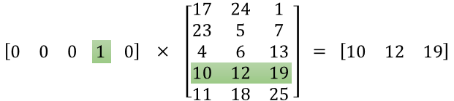
Notice how this is essentially an lookup
http://mccormickml.com/2016/04/19/word2vec-tutorial-the-skip-gram-model/

Slide 7
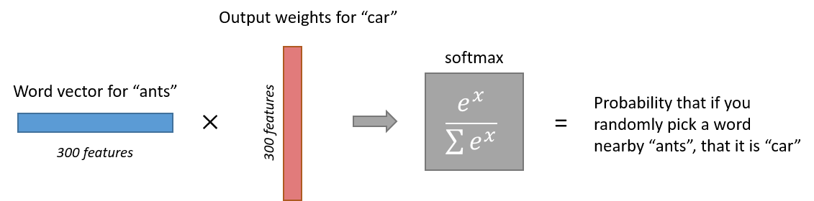
Output layer
Note that neural network does not know anything about the offset of the output word relative to the input word. It does not learn a different set of probabilities for the word before the input versus the word after.
To understand the implication, let's say that in our training corpus, every single occurrence of the word 'York' is preceded by the word 'New'. That is, at least according to the training data, there is a 100% probability that 'New' will be in the vicinity of 'York'. However, if we take the 10 words in the vicinity of 'York' and randomly pick one of them, the probability of it being 'New' is not 100%; you may have picked one of the other words in the vicinity.

Slide 8
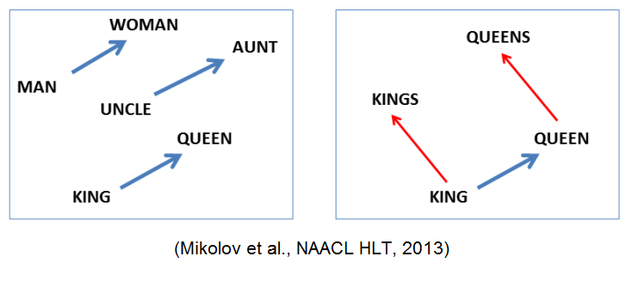
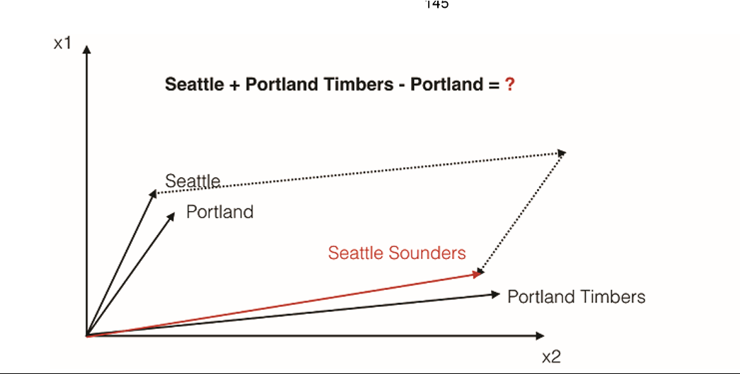
Words and vectors
From “Natural Language Processing in Action”, by Lane, Howard, Hapke from Manning Press.

Slide 9
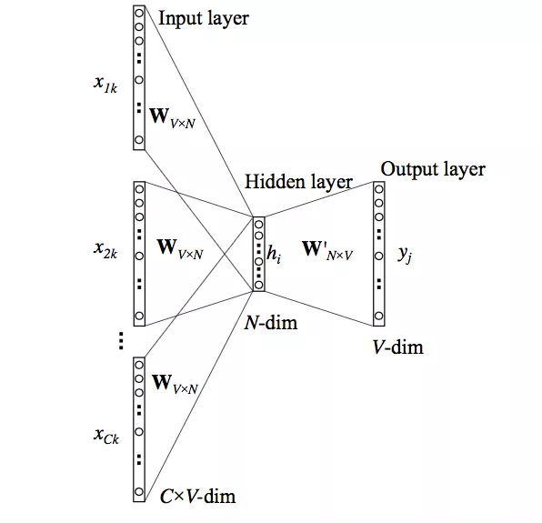
Continuous bag of words approach multiple context words as input

Slide 10
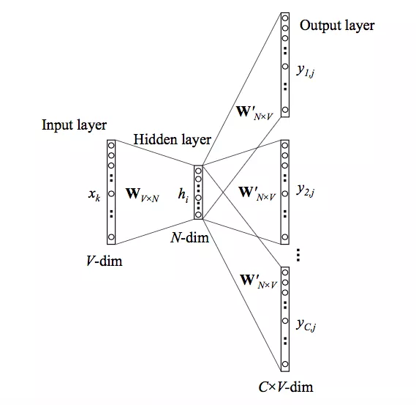
Skip Gram Approach one input word multiple output words

Slide 11
Compare CBOW and Skip Gram "watch movies rather than read books"
Training instances for CBOW (assume size of 2) would look like :
Input : [("watch", "rather", "than)], Output : [("movies")]
Input : [("watch", "movies", "than", "read")], Output : [("rather")]
if the input is [("watch", "movies", "than", "read")],
then desired output would be [("rather")]
Skip Gram architecture, if the input is [("rather")]
then the desired output would be
[("watch", "movies", "than", "read")].

Slide 12
Code flow to make your own model
Obtain and prepare a text corpus using nltk or similar
tokens = nltk.wordpunct_tokenize(doc) #usually in a loop or list comp
corpastokens = [token.lower() for token in tokens……]
Create a word2vec instance model passing in the corpus as a list of lists of tokenized sentences
import gensim
from gensim.models.keyedvectors import KeyedVectors
from gensim.models.word2vec import Word2Vec
model = Word2Vec( corpastokens,workers=num_workers,size=num_features, min_count=min_word_count,window=window_size,
sample=subsampling,hs=1,sg=skorcb)
Explore
model.wv[‘aword’]
Let’s go through a sample
Full source posted to https://github.com/jimwill3/NY-AZML-Meetup

Slide 13
appendix
Concepts behind word2vec and word embedding
http://mccormickml.com/2016/04/19/word2vec-tutorial-the-skip-gram-model/
https://machinelearningmastery.com/develop-word-embeddings-python-gensim/
Books:
Natural_Language_Processing_in_Action – manning.com

